Slide 1
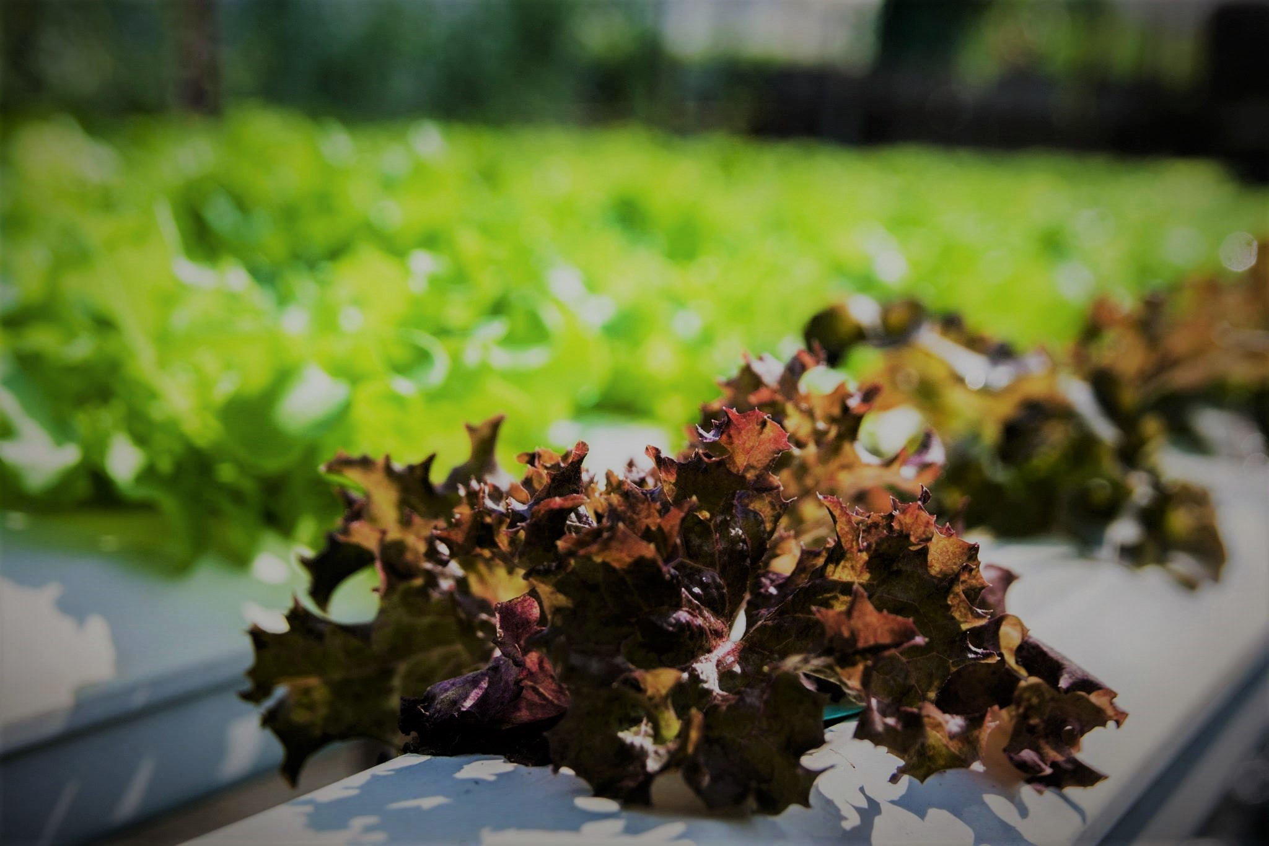
Bearing Hydroponics
:: THAILAND :: Training Course on “ Innovative Production with Hydroponic Technique”
Rachot Phuengsuk

Slide 2
:: THAILAND :: Training Course on “ Innovative Production with Hydroponic Technique”
Outline
Introduction
Farm overview
Bearing hydroponics products
Hydroponics
Control system
Workshop
1

Slide 3
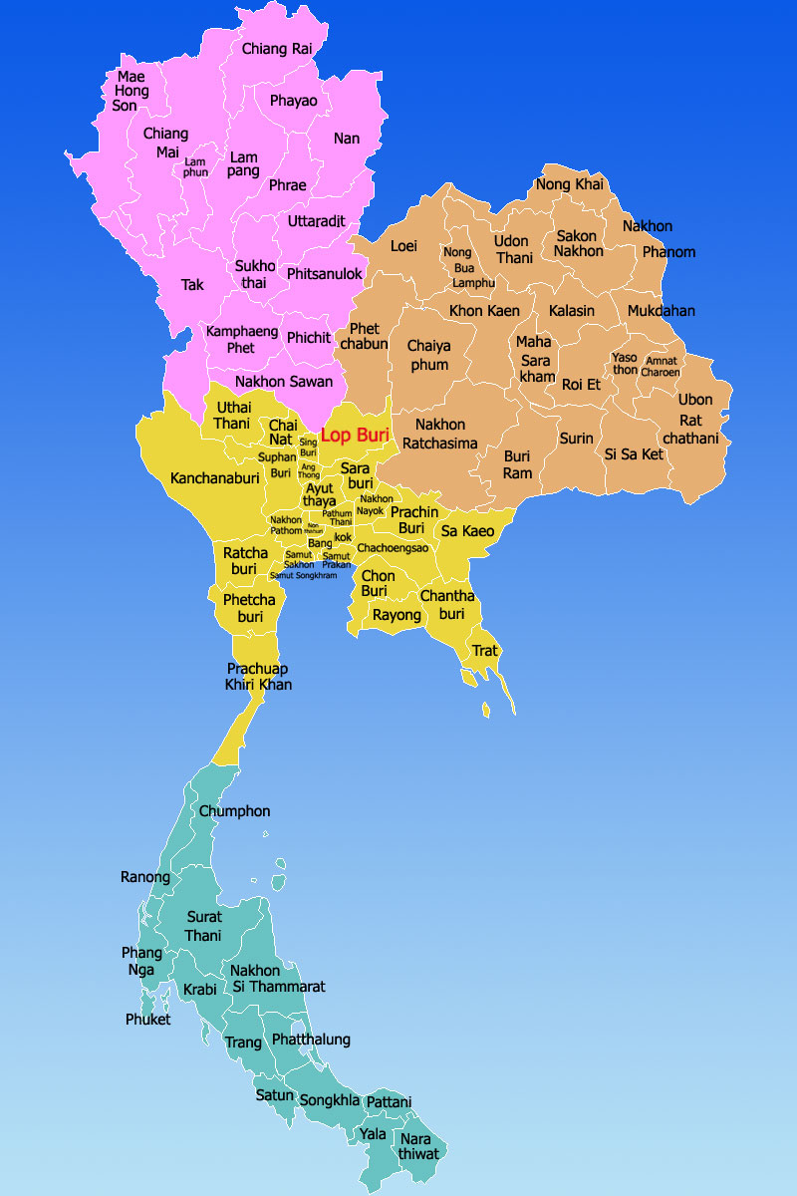
:: THAILAND :: Training Course on “ Innovative Production with Hydroponic Technique”
Samutprakarn, Thailand
Central of Thailand
2,089,200 Populations
6 District
724 village
1,004.1 km2
13,550 Farmer household
Samutprakarn Province
2

Slide 4
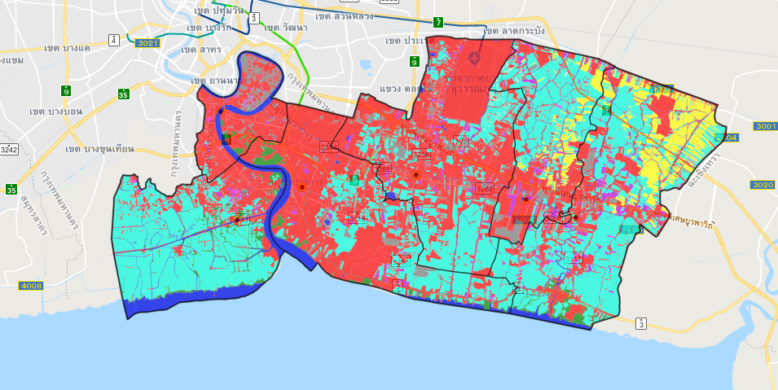

:: THAILAND :: Training Course on “ Innovative Production with Hydroponic Technique”
Area
 | Type | Area | Percent
 | Community Areas and Buildings | 245,830 | 40.67
 | Aquaculture facilities | 230,658 | 38.16
 | Water area | 40,147 | 6.64
 | Land | 30,048 | 4.97
 | Miscellaneous area | 28,436 | 4.70
 | Forest area | 13,379 | 2.21
 | Lowland | 12,920 | 2.13
 | Fruit | 1,765 | 0.29
 | Aquatic plant | 1,086 | 0.17
 | Field and animal farm | 65 | 0.01
 | Perennial | 63 | 0.01
 | Garden tree | 25 | 0.00
Source
3

Slide 5
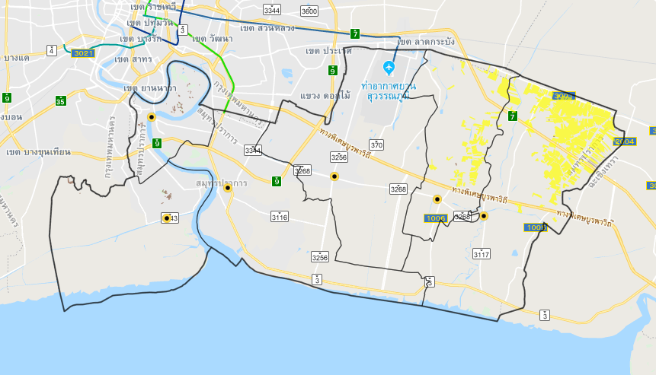
:: THAILAND :: Training Course on “ Innovative Production with Hydroponic Technique”
Main economic crop
Type | Area (Rai) | Percent
Rice | 29,390 | 97.22
Coconut | 840 | 2.77
Source
4

Slide 6
:: THAILAND :: Training Course on “ Innovative Production with Hydroponic Technique”
MELON#1
MELON#2
Melon
System : Soil
Dimension : 6 x 12 m.(4)
Production : 200 / crop
MELON#3
MELON#4
NFT HYDROPONICS SYSTEM
Lettuce
System : NFT hydroponics
Dimension : 1.6 x 12 m. (12)
Production : 144 kg. / crop
ROAD
CENTRAL
5

Slide 7
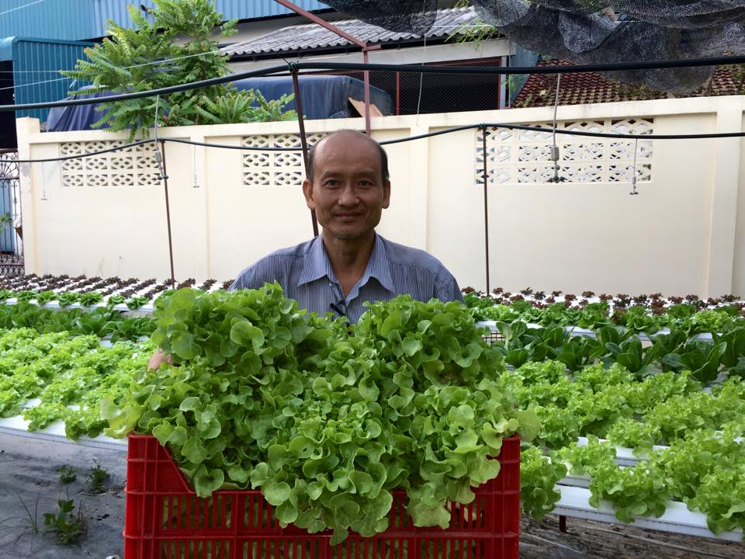
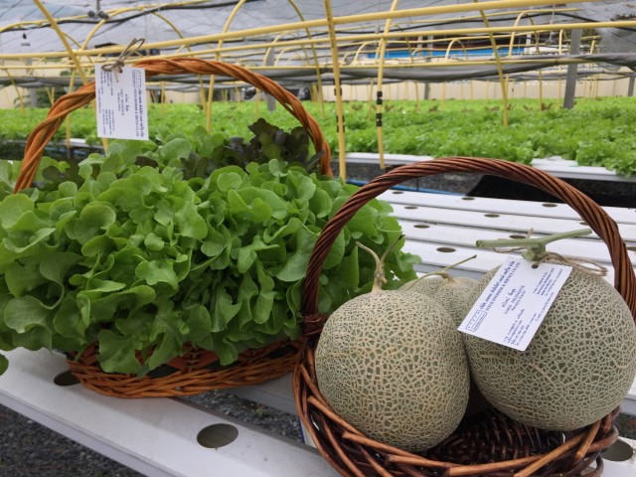
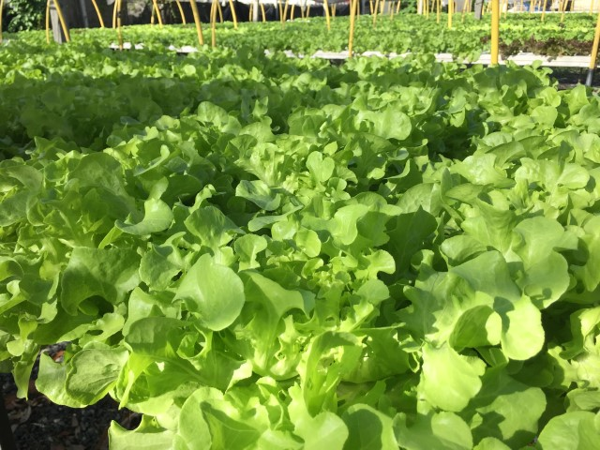
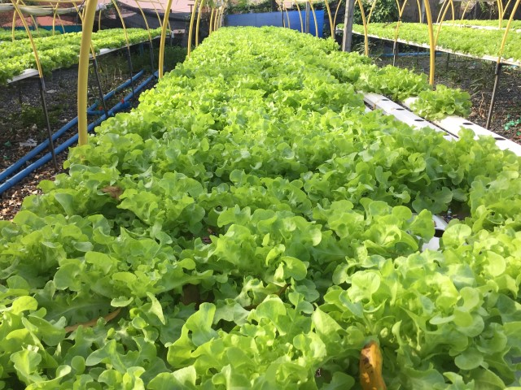
LETTUCE WITH HYDROPONICS
:: THAILAND :: Training Course on “ Innovative Production with Hydroponic Technique”
6

Slide 8
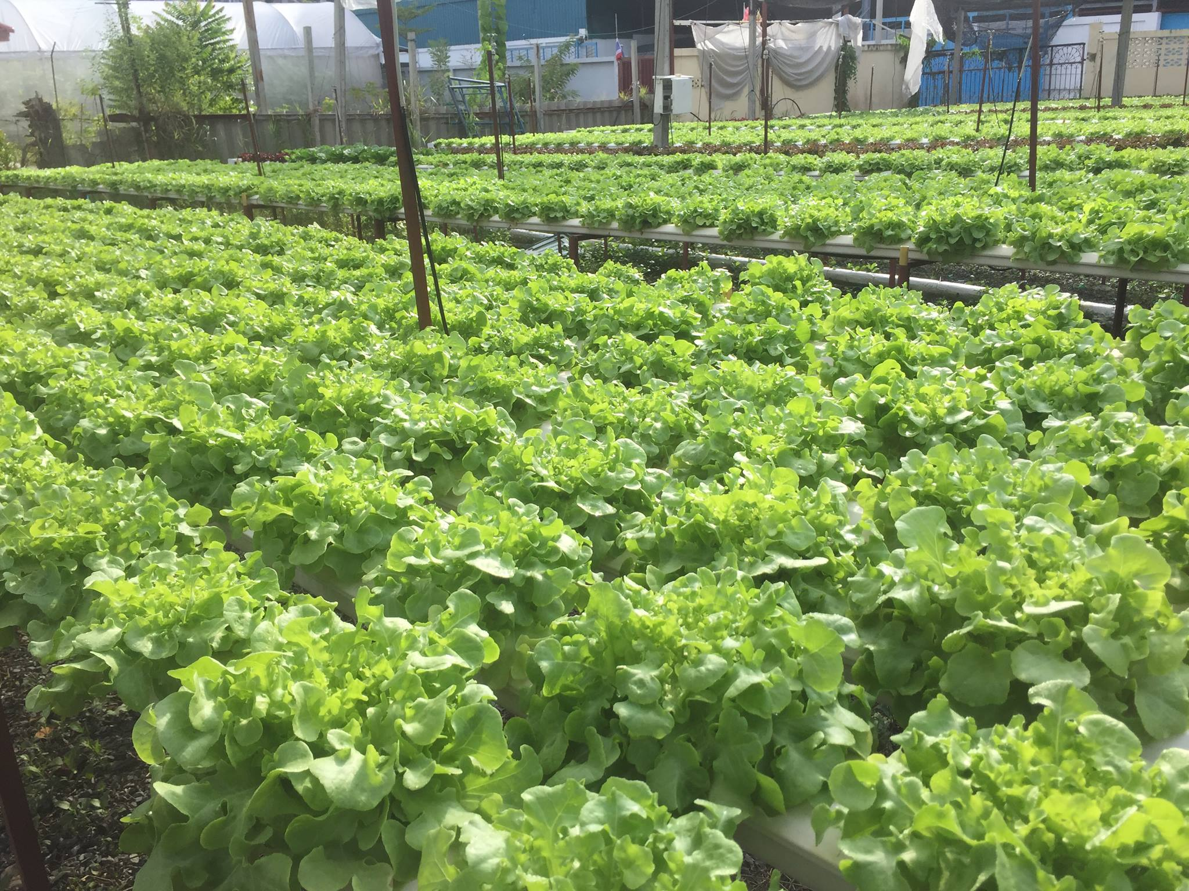
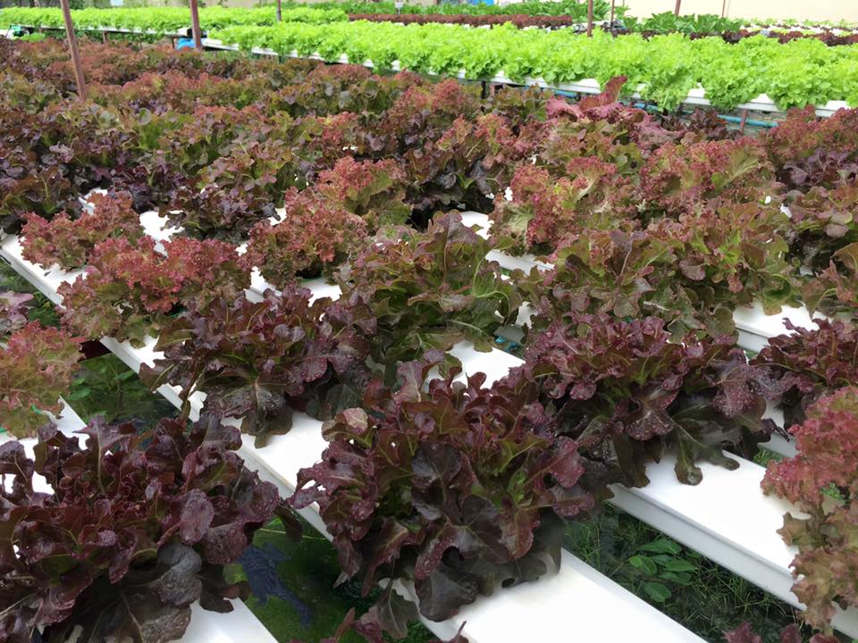
:: THAILAND :: Training Course on “ Innovative Production with Hydroponic Technique”
LETTUCE WITH HYDROPONICS(cont.)
7

Slide 9
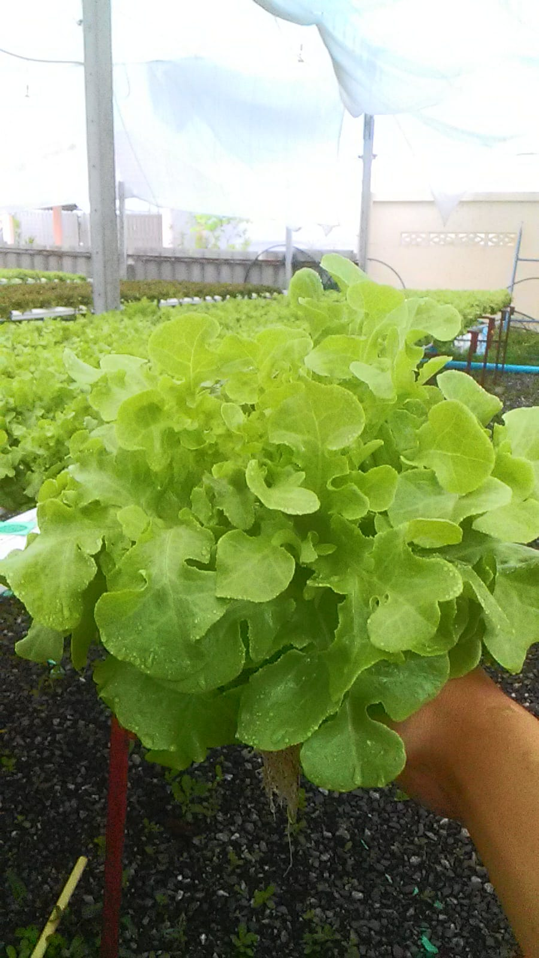
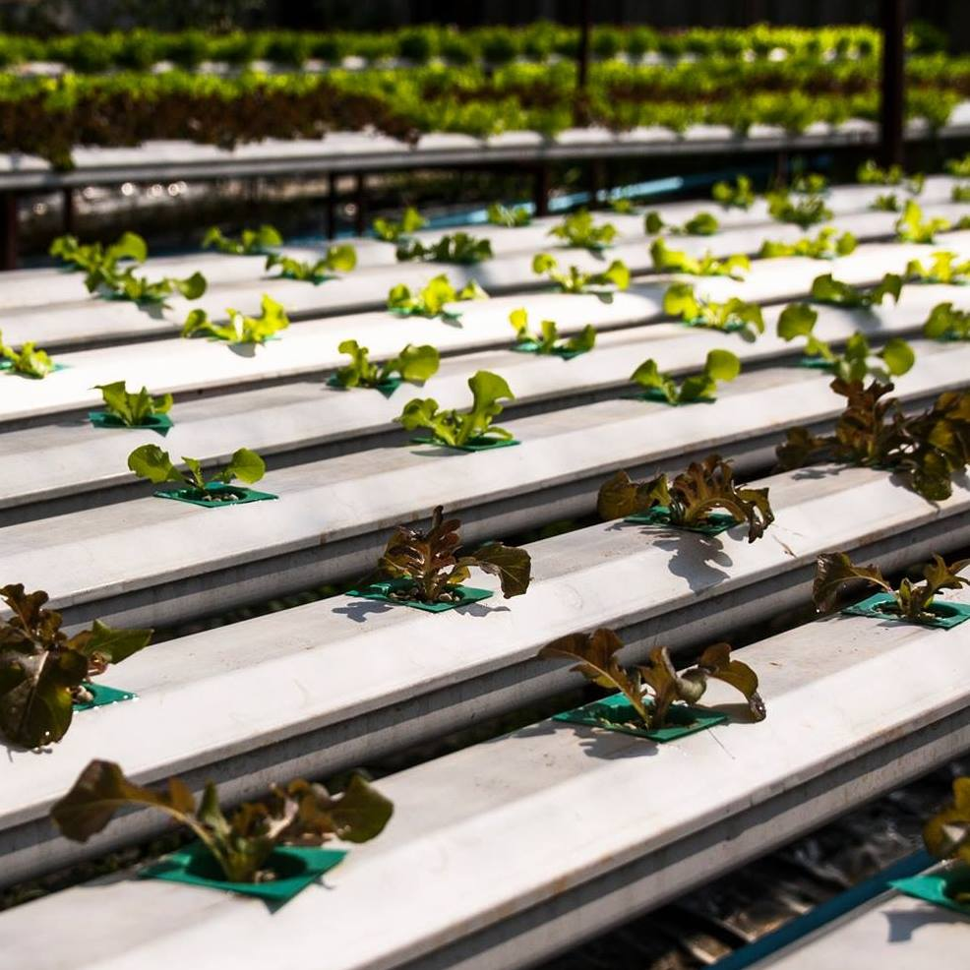
:: THAILAND :: Training Course on “ Innovative Production with Hydroponic Technique”
LETTUCE WITH HYDROPONICS(cont.)
8

Slide 10
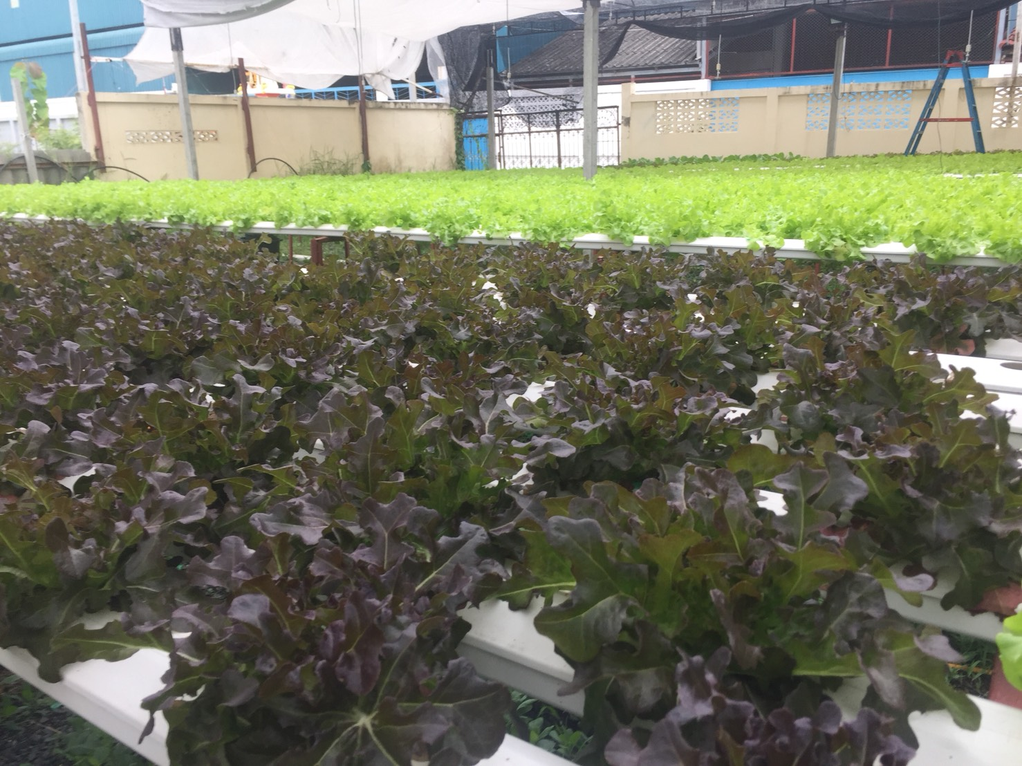
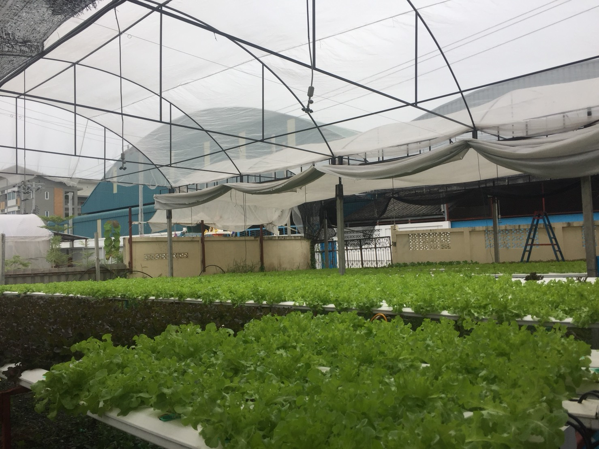
:: THAILAND :: Training Course on “ Innovative Production with Hydroponic Technique”
LETTUCE WITH HYDROPONICS(cont.)
9

Slide 11
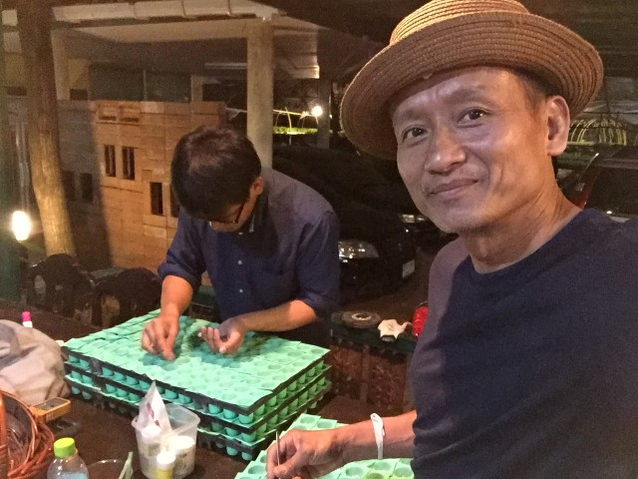
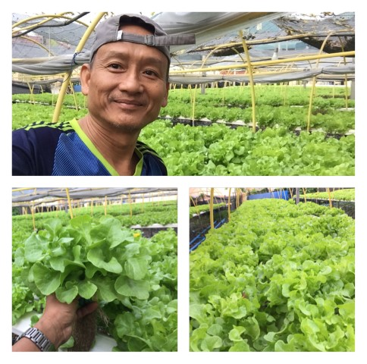
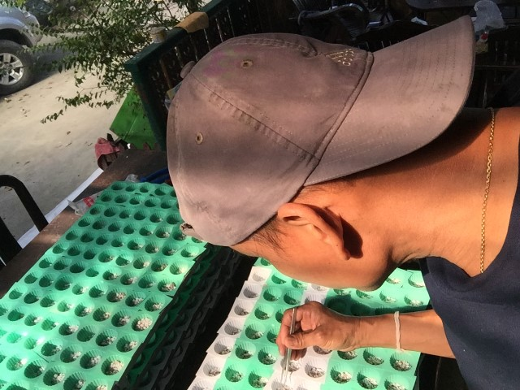
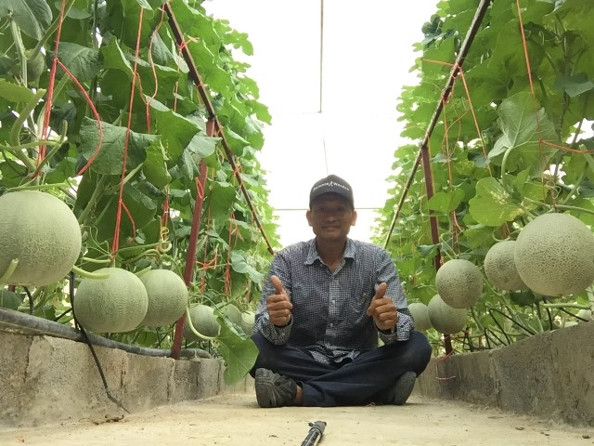
:: THAILAND :: Training Course on “ Innovative Production with Hydroponic Technique”
LETTUCE WITH HYDROPONICS(cont.)
10

Slide 12
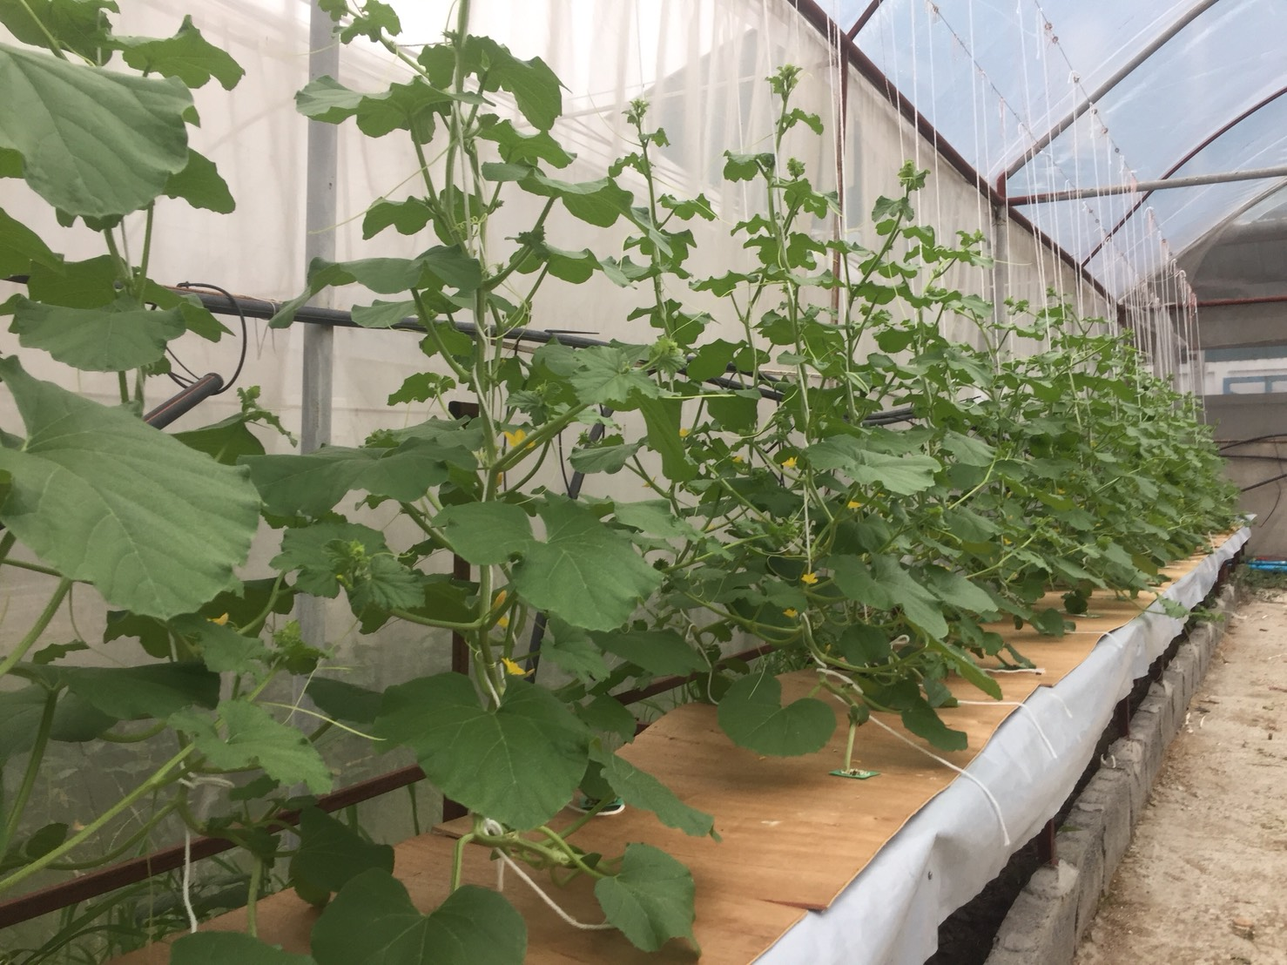
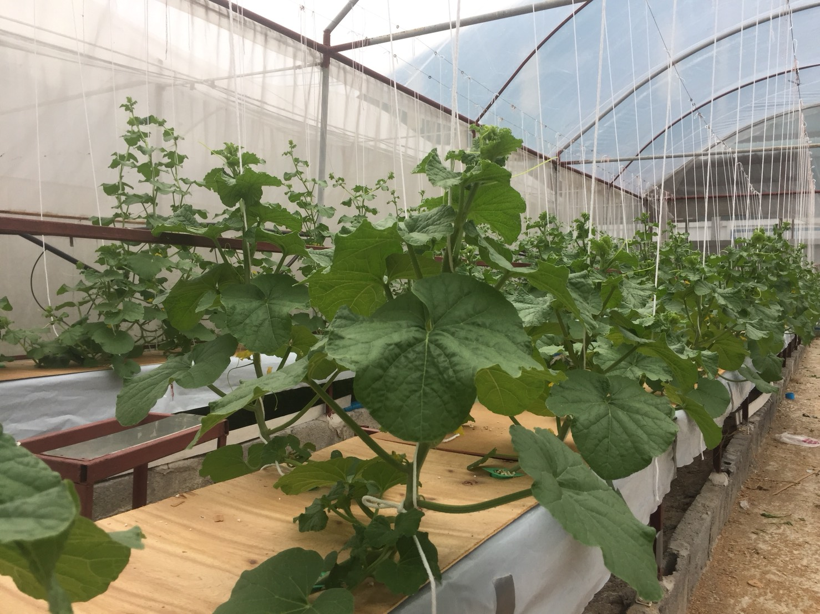
MELON WITH HYDROPONICS
:: THAILAND :: Training Course on “ Innovative Production with Hydroponic Technique”
11

Slide 13
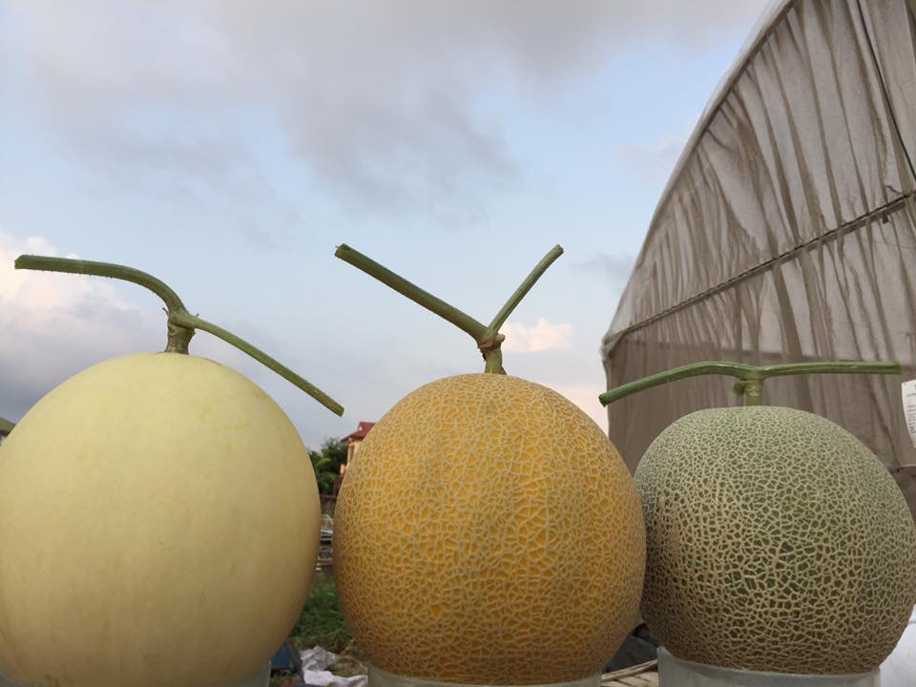
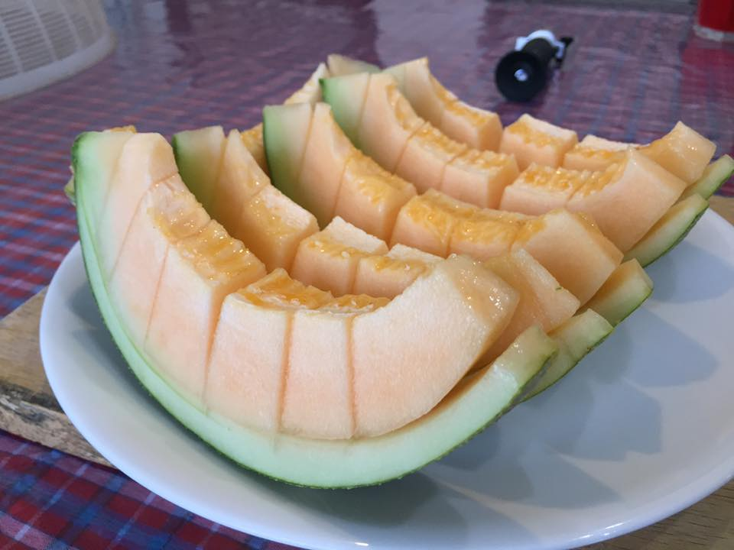
MELON WITH HYDROPONICS
:: THAILAND :: Training Course on “ Innovative Production with Hydroponic Technique”
12

Slide 14
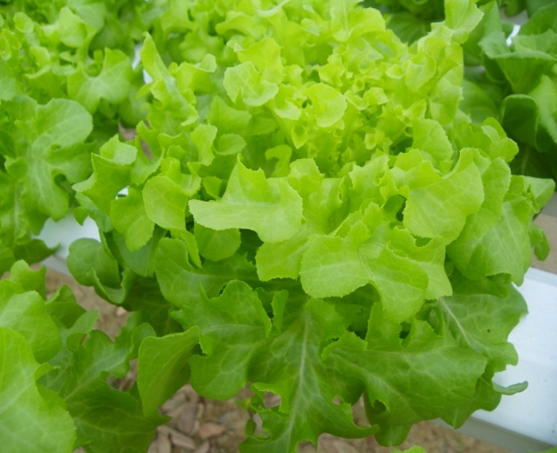
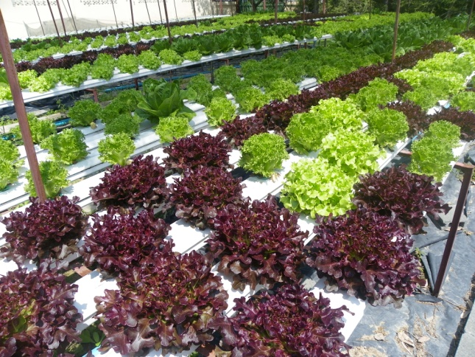
What is hydroponics?
:: THAILAND :: Training Course on “ Innovative Production with Hydroponic Technique”
Hydroponic is greek term hydro, means water and ponos, means power
Hydroponic means plant cultivation that use water without soil as medium or soilless
13

Slide 15
What is hydroponics?
:: THAILAND :: Training Course on “ Innovative Production with Hydroponic Technique”
Advantages
Plant is easy to generated depend on land condition and seasons
Adjustable growth and harvest quality
Less employee cost - Cleaner and more hygienic product
Less water and fertilizer needs (Environmental friendly)
Shorter planting time
Less operational costs
14

Slide 16
What is hydroponics?
:: THAILAND :: Training Course on “ Innovative Production with Hydroponic Technique”
Weakness
Initial investment cost is more expensive
Highly affected by fertilizer concentration and composition, pH and temperature
15

Slide 17
:: THAILAND :: Training Course on “ Innovative Production with Hydroponic Technique”
NFT
Hydroponics
FAD
DFT
Natural
Peat, coco peat, saw dust
Soilless culture
Aeroponics
Organic substrate
Synthetic Foam, fiber, plastic
Substrate culture
Inorganic substrate
Sand, gravel, rockwool, perlite, ceramic
15

Slide 18
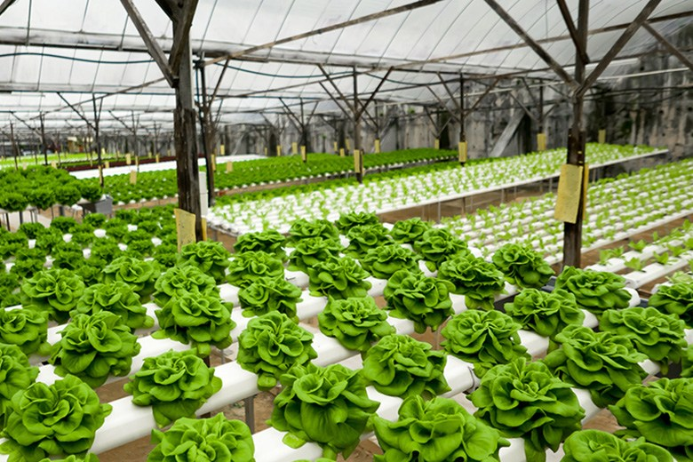
Hydroponics types
:: THAILAND :: Training Course on “ Innovative Production with Hydroponic Technique”
Aeroponics
NFT (Nutrient Film Technique)
Drip Irrigation
DFT (Deep Flow Technique)
16

Slide 19
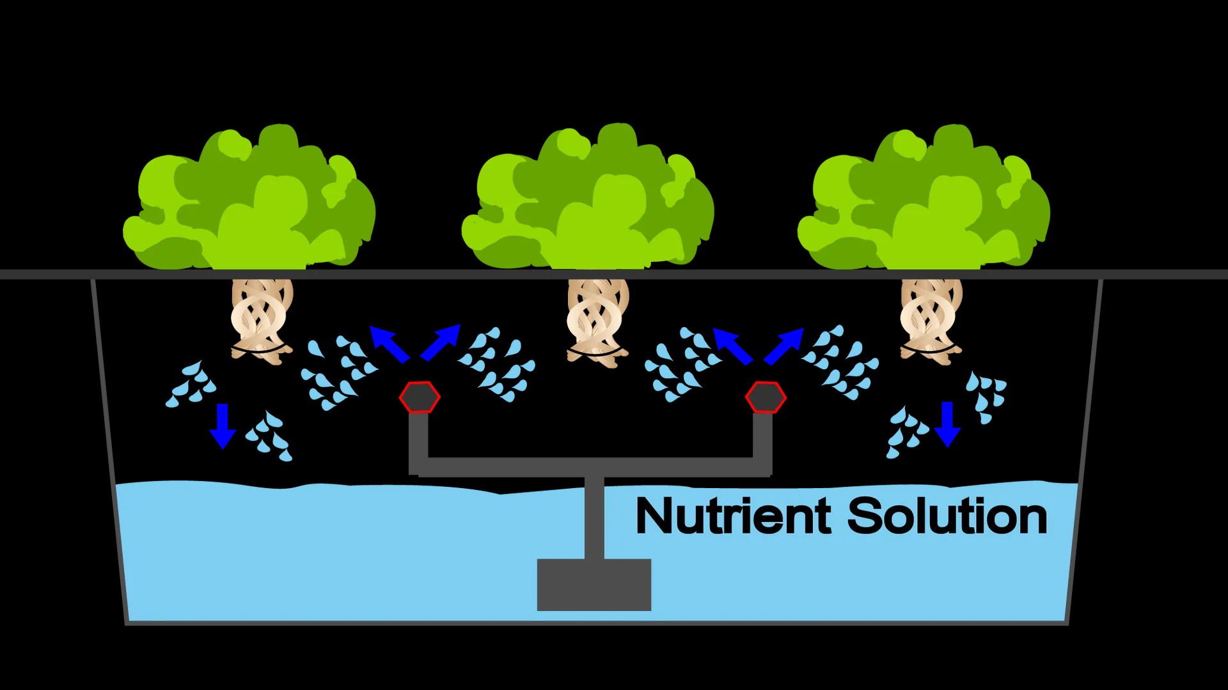
Aeroponics
:: THAILAND :: Training Course on “ Innovative Production with Hydroponic Technique”
Root
Nutrient tank
Spray nozzle
Water pump
17

Slide 20
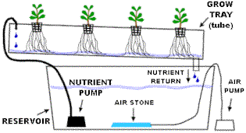
NFT (Nutrient Film Technique)
:: THAILAND :: Training Course on “ Innovative Production with Hydroponic Technique”
17

Slide 21
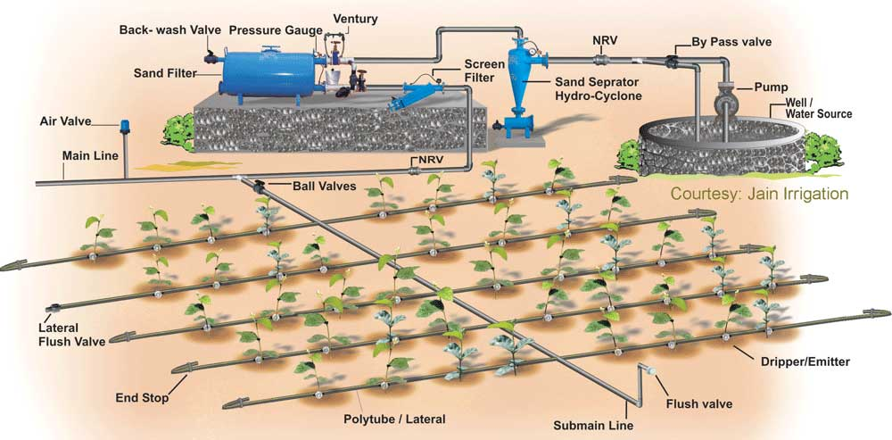
Drip Irrigation
:: THAILAND :: Training Course on “ Innovative Production with Hydroponic Technique”
17

Slide 22
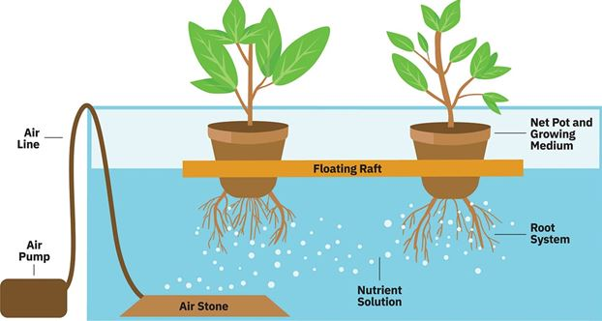
DFT (Deep Flow Technique)
:: THAILAND :: Training Course on “ Innovative Production with Hydroponic Technique”
17

Slide 23
Growth factor
:: THAILAND :: Training Course on “ Innovative Production with Hydroponic Technique”
Internal factor
Environment factors
Genetic factor
Self hormone
Synthetic hormone
Temperature
Humidity
Light
pH
Nutrient
Oxygen
Carbon dioxide
DO
15

Slide 24
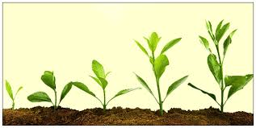
:: THAILAND :: Training Course on “ Innovative Production with Hydroponic Technique”
Chlorophyll
CO2
+
H2O
C6H12O6
+
6O2
Light
15

Slide 25
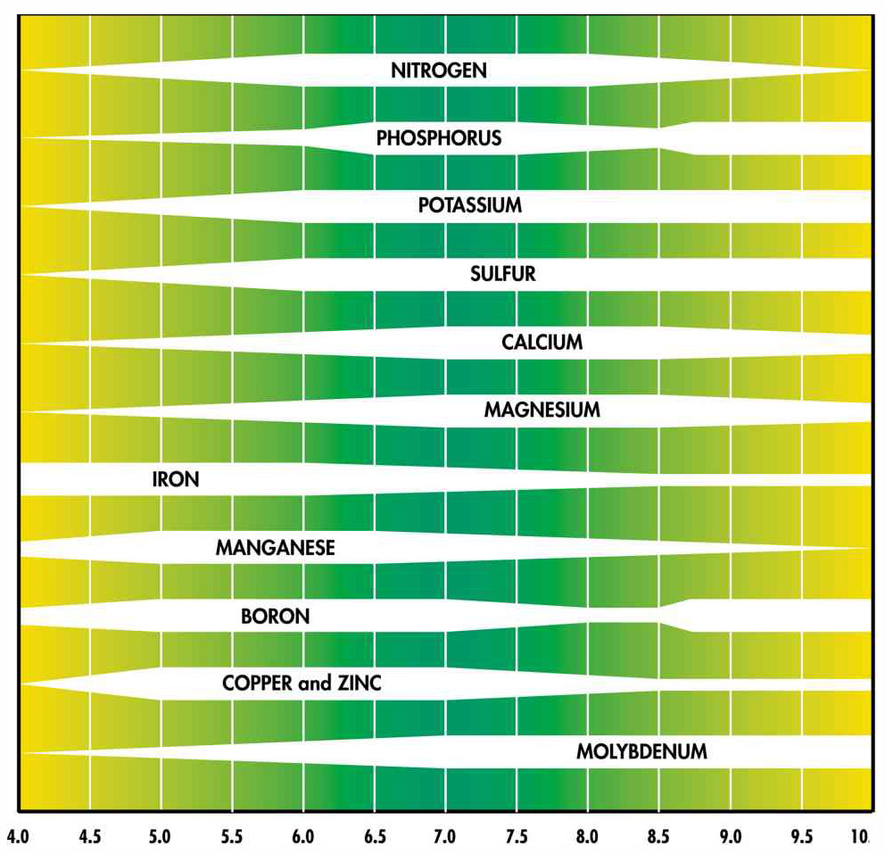
pH
:: THAILAND :: Training Course on “ Innovative Production with Hydroponic Technique”
15

Slide 26
pH
:: THAILAND :: Training Course on “ Innovative Production with Hydroponic Technique”
Calcium
Magnesium
Potassium
Ammonium
Nitrate
Sulphate
Phosphate
Absorb
Absorb
Root
H+
OH-
pH
decrease
pH
Increase
15

Slide 27
Nutrient
:: THAILAND :: Training Course on “ Innovative Production with Hydroponic Technique”
Primary
Secondary
Micronutrient
Carbon
Hydrogen
Oxygen
Nitrogen
Phosphorous
Potassium
Calcium
Sulphur
Magnesium
Iron
Manganese
Copper
Zinc
Boron
Molybdenum
Chlorine
15

Slide 28
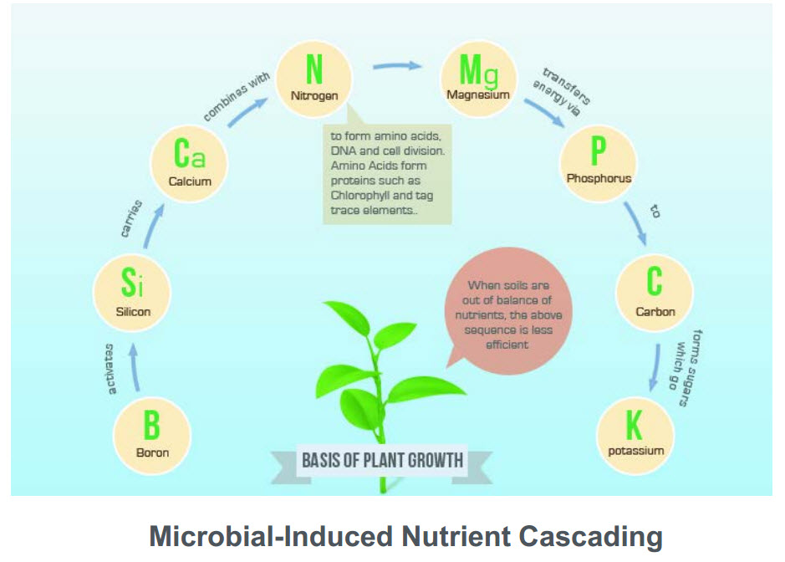
:: THAILAND :: Training Course on “ Innovative Production with Hydroponic Technique”
โบรอน > ซิลิคอน > แคลเซียม > ไนโจรเจน > แมกนีเซียม > ฟอสฟอรัส > คาร์บอน > โพแทสเซียม
15

Slide 29
Example nutrient for lettuce 10 liters
:: THAILAND :: Training Course on “ Innovative Production with Hydroponic Technique”
Stock A
Calcium nitrate (15-0-0) 1,150 g.
Fe-DTPA 30 g.
Fe-EDTA 30 g.
Fe-EDDHA 30 g.
DTPA pH range < 6.0
EDTA pH range < 7.0
EDDHA ph range < 10.0
15

Slide 30
Example nutrient for lettuce 10 liters
:: THAILAND :: Training Course on “ Innovative Production with Hydroponic Technique”
Stock B
Potassium nitrate (13-0-46) 600 g.
Magnesium sulphate 500 g.
Monopotassium phosphate (0-52-34) 300 g.
Micronutrient 50 g.
Manganese EDTA 10 g.
15

Slide 31
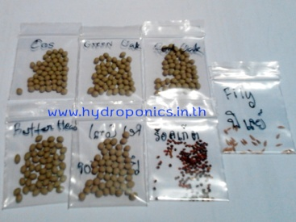
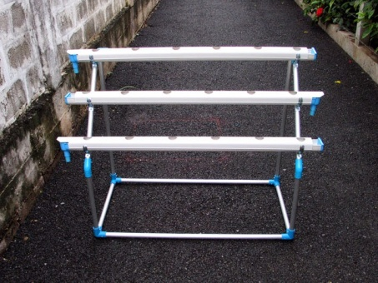
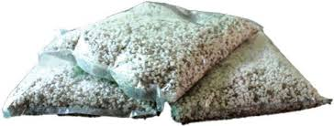
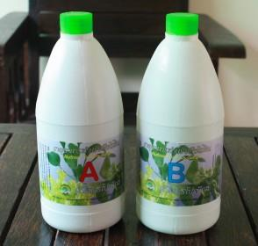
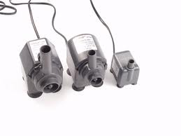
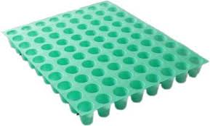
:: THAILAND :: Training Course on “ Innovative Production with Hydroponic Technique”
Equipment for growing
Seed
Media (Perlite & Vermiculite)
Tray
Nutrient A & B
Growing Cup
Pump
18

Slide 32
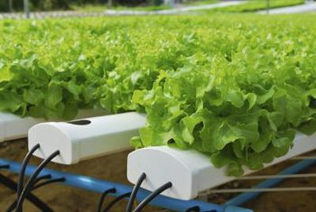
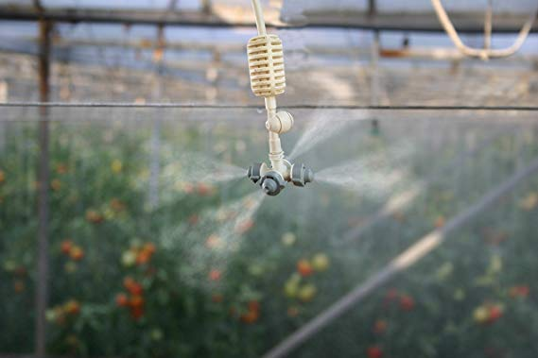
:: THAILAND :: Training Course on “ Innovative Production with Hydroponic Technique”
Setup the system
Step :
Setup the system by making support and tray slope at 15%
Setup water circulation pipe from nutrient tank to tray and return pipe for water return
Setup water spray for maintain water level in vegetable
19

Slide 33
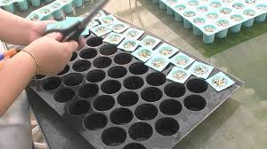
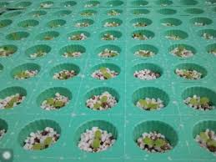
:: THAILAND :: Training Course on “ Innovative Production with Hydroponic Technique”
Prepare seeding
Step :
1. Mix perlite and Vermiculite ratio 4:1
2. Put a seed in a media deep 0.5 cm.
3. Watering 3 times (Moring, Noon, Evening)
20

Slide 34
:: THAILAND :: Training Course on “ Innovative Production with Hydroponic Technique”
Planning
Week 4-6 (Growing)
3 Tables
1152 plants
Week 4-6 (Growing)
3 Tables
Week 4-6 (Growing)
3 Tables
Week 4-6 (Growing)
3 Tables
Week 2-3 (Nursery 2)
Week 1 (Nursery 1)
Seeding every 7 days
21

Slide 35
:: THAILAND :: Training Course on “ Innovative Production with Hydroponic Technique”
Planning
Week 4-6 (Growing)
3 Tables
1152 plants
Week 4-6 (Growing)
3 Tables
Week 4-6 (Growing)
3 Tables
Week 4-6 (Growing)
3 Tables
Week 2-3 (Nursery 2)
Week 1 (Nursery 1)
22

Slide 36
:: THAILAND :: Training Course on “ Innovative Production with Hydroponic Technique”
Planning
Week 4-6 (Growing)
3 Tables
1152 plants
Week 4-6 (Growing)
3 Tables
Week 4-6 (Growing)
3 Tables
Week 4-6 (Growing)
3 Tables
Week 2-3 (Nursery 2)
Week 1 (Nursery 1)
23

Slide 37
:: THAILAND :: Training Course on “ Innovative Production with Hydroponic Technique”
Planning
Week 4-6 (Growing)
3 Tables
1152 plants
Week 4-6 (Growing)
3 Tables
Week 4-6 (Growing)
3 Tables
Week 4-6 (Growing)
3 Tables
Week 2-3 (Nursery 2)
Week 1 (Nursery 1)
24

Slide 38
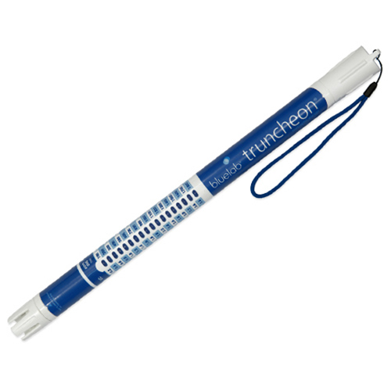
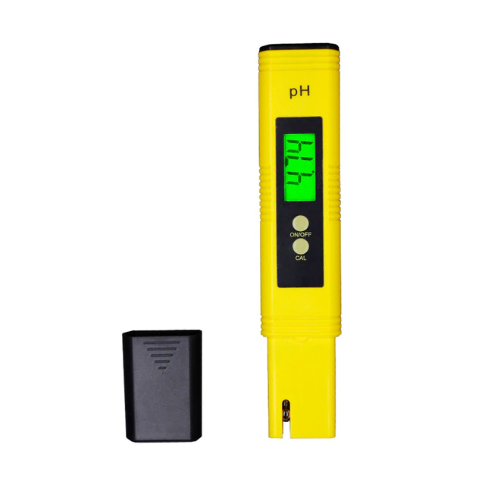
:: THAILAND :: Training Course on “ Innovative Production with Hydroponic Technique”
Measurements
EC Meter
pH Meter
25

Slide 39
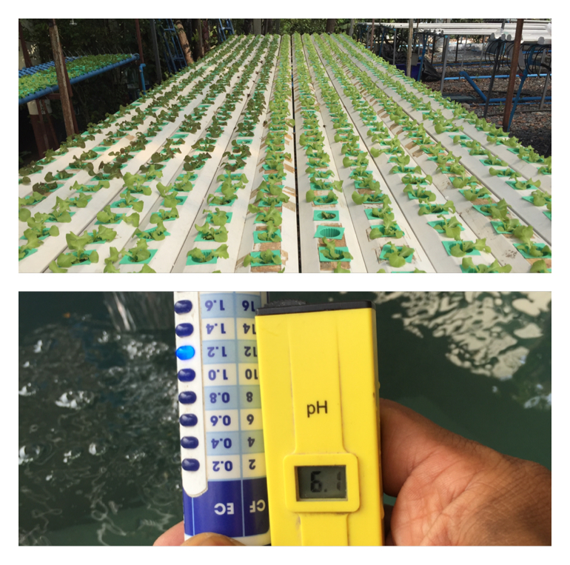
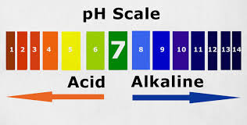
:: THAILAND :: Training Course on “ Innovative Production with Hydroponic Technique”
Daily works
Step :
Check water level in nutrient tank
Measure pH and EC level
Adjust pH in 6.0-6.5 (Morning, evening)
Adjust EC 1.6 mS/cm (Morning)
26

Slide 40
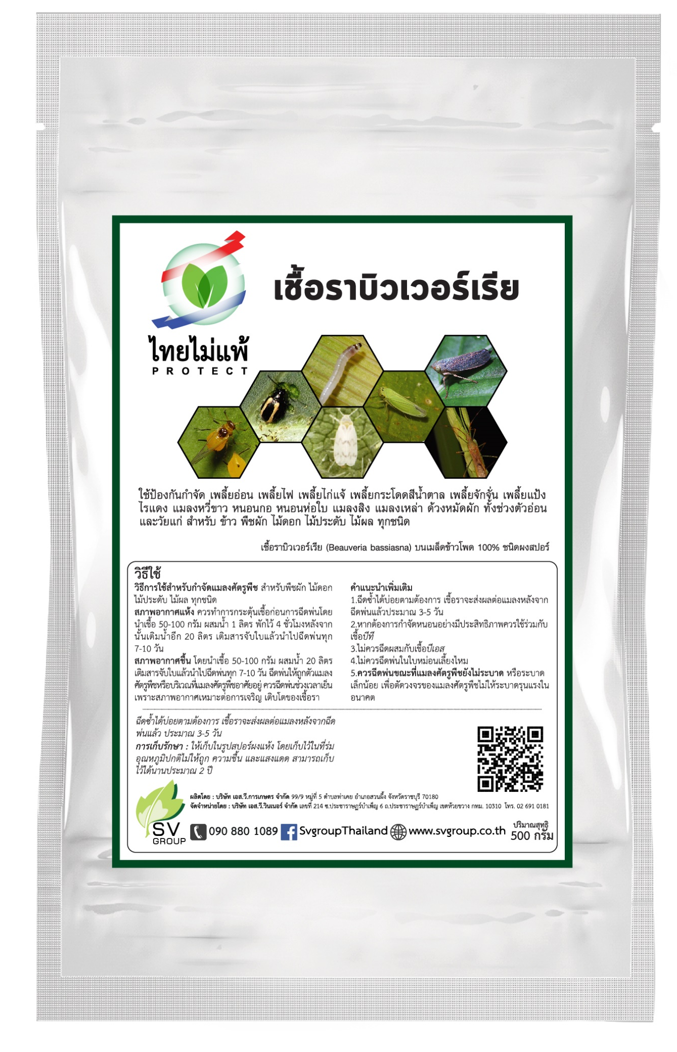
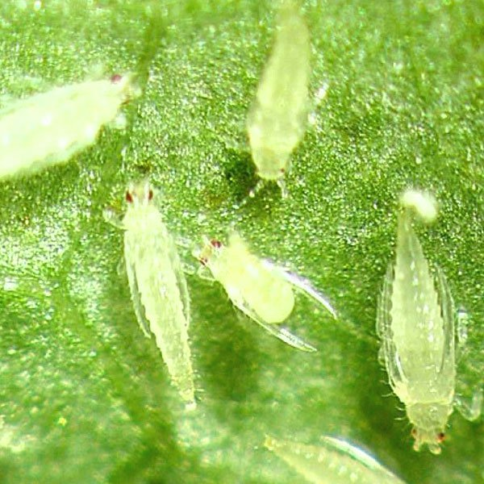
:: THAILAND :: Training Course on “ Innovative Production with Hydroponic Technique”
Problem
Insect:
Thrips
Beauveria bassiana
27

Slide 41
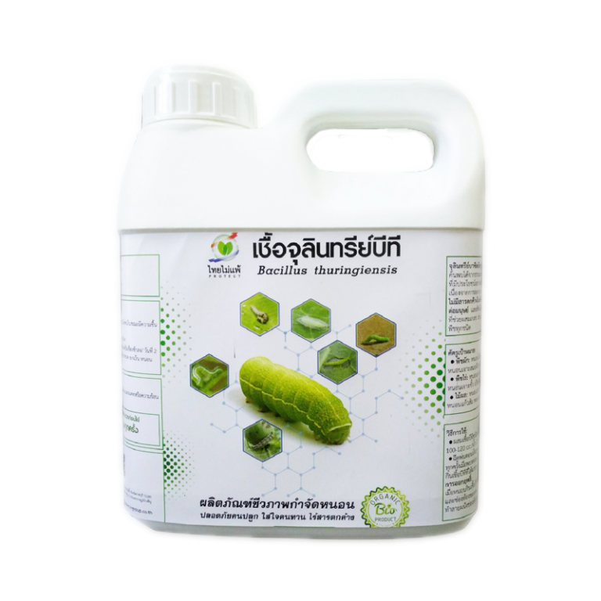
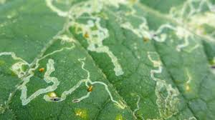

:: THAILAND :: Training Course on “ Innovative Production with Hydroponic Technique”
Problem
Insect:
Worm
Bacillus thuringiensis (BT)
28

Slide 42

:: THAILAND :: Training Course on “ Innovative Production with Hydroponic Technique”
Problem
Plant diseased:
29

Slide 43


:: THAILAND :: Training Course on “ Innovative Production with Hydroponic Technique”
Problem
Plant diseased:
Trichoderma harzianum for protect plant diseased
30

Slide 44







:: THAILAND :: Training Course on “ Innovative Production with Hydroponic Technique”
System Overview
Cloud Database
pH Controller
pH Down Pump
CENTRAL
Nutrient Tank
EC Controller
Nutrient Pump
Printer
Mobile
31

Slide 45

Water management for Hydroponics
:: THAILAND :: Training Course on “ Innovative Production with Hydroponic Technique”
Manual/Auto
EC Control
pH Control
Temp. Control
Main water Control
Water spray
32

Slide 46

:: THAILAND :: Training Course on “ Innovative Production with Hydroponic Technique”
Doser
Nutrient pump
pH Down pump
33

Slide 47

Water management for Greenhouse Hydroponics
:: THAILAND :: Training Course on “ Innovative Production with Hydroponic Technique”
Manual/Auto
EC Control
pH Control
34

Slide 48

:: THAILAND :: Training Course on “ Innovative Production with Hydroponic Technique”
Monitoring
Low cost
PC, Laptop
Mobile
35

Slide 49


:: THAILAND :: Training Course on “ Innovative Production with Hydroponic Technique”
Alarm with LINE application
36

Slide 50

THANK YOU
Q&A
https://github.com/rachot/hydroponics

